Slide 1
Moral hazard and copayments
HSPM 714 J50
10/3/2013

Slide 2
Moral hazard
… if having insurance increases the probability that an insured-against event will occur.
  For health care …
… if having health insurance means you’ll get more on health care.
  More than what?
    The whole idea of having insurance?

Slide 3
Moral hazard
  An efficiency problem:
If your cost < marginal social cost
then you will consume services with low marginal benefit
  Gradually diminishing returns assumed

Slide 4
Moral hazard
If you consume services with low marginal benefit
Then we could make you better off by giving you instead something with a higher marginal benefit to you that would cost us the same or less.
  Which fits the definition of more efficient – making everybody better off or just as well off

Slide 5
Moral hazard in health care reiterated
If you don’t have to pay the full price of your care
  Thanks to your having insurance
  Or thanks to public programs or provider charity
Then you will get services or goods that you don’t need much
  In jargon, the marginal benefit to you will be less than the marginal cost of the service or good

Slide 6
What can reduce moral hazard?
The medical professional’s judgment
  But then the doctor is not just your agent
    The big fear in “socialized medicine” and managed care
Copayments
  Reduce the difference between your cost and the social cost
    What if the price is bigger than the cost?
      As in Reinhardt’s incremental cost article

Slide 7
RAND health insurance experiment
Brook, R.H., et al, "Does Free Care Improve Adults' Health? Results from a Controlled Trial of Cost Sharing in Health Insurance," N Engl J Med, December 8, 1983, 309, pp. 1426-1434.
How big is moral hazard in health insurance?
How much does health insurance induce people to buy health care that they don't much need?
Randomized groups

Slide 8
RAND health insurance experiment
Brook’s is from the $70 million government-funded RAND health insurance study done in the late 1970s. In this part of the study:
3958 adults (teens up to Medicare) in diverse locations
Followed over 8 years.
Copayment schemes tried:
  Free care – no copayment
  Various copayments of 25 to 50%
  95% payment for all services until the family had spent 15% of its income or $1000, whichever was less.
Notes:
(I imagine they used 95% rather than 100% to give the families an incentive to send in their medical bills.)

Slide 9
Current value of that $1000 deductible
 | Med care CPI-U 1982-84=100
2013 August | 426.866 | $6,324
1979 annual | 67.5 | $1,000

Slide 10
Notes:
Adults who had to pay used about 2/3 of the ambulatory visits and hospitalizations of those who didn't. An earlier article (Newhouse et al, NEJM 305(25) Dec. 17, 1981, 1501-7) reported this. There was little or no significant difference among the pay plans. As far as they could tell, 25% copayment had the same effect as 95%.

Slide 11
Effect of copayment on health care demand
Adults who had to pay used about 2/3 of the ambulatory visits and hospitalizations of those who didn't.
  An earlier article (Newhouse et al, NEJM 305(25) Dec. 17, 1981, 1501-7) reported this.
There was little or no significant difference among the pay plans. As far as they could tell, 25% copayment had the same effect as 95%.

Slide 12
Income and the demand response to copayment
Low income families responded more to copayments than higher income families
but not by much in most years and locations.
Low income families with illnesses would exceed their deductible sooner than higher income families, because the deductible was 15% of family income.

Slide 13
Cash payments to equalize benefit
People who had the 95% copayment plan got a cash payment of about $80 a month.
  $506 at 2013’s health care prices
This gave them cash that they could spend on health care
  or they could chose to spend it on something else instead.

Slide 14
Cash payments try to separate the substitution effect from the income effect
The investigators thought that many people would rather forgo medical care for some conditions and spend the money saved on something else.
If care is free, a person may go to the emergency room and spend $100 worth of society's resources on treatment of a headache, say. If the person has to pay part or all of that $100, he or she may prefer to take two 7-cent ibuprofens at home and spend the other $99.86 on something else. Either way uses up $100 worth of society's resources, but the second way gives the person with the headache more “utility.”
The cash payment is like giving the person the $100.

Slide 15
Copayments and Need
Effect of copayments on health
For the whole population, differences in health status are found only for persons with poor vision or high blood pressure.
Among elevated-risk persons (worse 25%), free plan had:
Lower blood pressure (at 0.07 level),
Better far vision (0.02 level)
Lower risk of dying (0.001 level)

Slide 16
Copayments make health worse for lower income people
The impact of cost sharing on health is clearest in lowest income group (bottom 20%).
Not clear if cost sharing has an impact on the health of the non-poor.
“Clear” here means statistically significant

Slide 17
Conclusion: Free care not cost-effective, at $725,000 per death averted
Authors say: Specifically targeted programs (vision, hypertension, especially for poor) are more cost-effective than free care for all at improving health among the public.
  (Cost effective means more bang for the buck.)
In other words, they advocate having programs for free care for the conditions for which they found a health effect of copayments.

Slide 18
Health habits and copayments
No effect found
Economic theory might imply that people will do more risky things if their health care will be paid for.

Slide 19
Limited of scope of the finding that free care is not cost-effective.
The high-copayment plan in the experiment was better than what the poor usually have. In real life, poor people don’t get a monthly stipend to compensate them for not having health insurance.
Sample excluded children and the elderly and the disabled.
Measures of health status not very sensitive.

Slide 20
What we’re willing to pay to meet similar need
Himmelstein, D.U., Woolhandler, S., "Free Care, Cholestyramine, and Health Policy," N Engl J Med, December 6, 1984, 311, pp. 1511-1514.

Slide 21
What we were willing to pay to meet similar need
Cholestyramine controls cholesterol and reduced the risk of death from heart disease, but daily therapy cost $1861.50 per year for the drug alone.
That works out to:
$9,300,000 average cost per life saved
$780,000 per coronary heart disease death or non-fatal MI (heart attack) averted.
Free health care for all men over 50 saves lives at an average cost per life saved of
$654,000 (compared with 95% copayment), or
$378,000 (compared with 50% copayment).
Free care for everyone saves lives at average cost of
$726,700.

Slide 22
Copayments and ER use
O'Grady, K.F., Manning, W.G., Newhouse, J.P., Brook, R.H., "The Impact of Cost Sharing on Emergency Department Use" N Engl J Med, August 22, 1985, 313, pp. 484-490.
The effect of copayment is greater for less serious diagnoses. Compared with free care, coinsurance plans combined had
77% as many visits for "more urgent" complaints
  lacerations,
  2nd degree burns,
  urinary tract infection,
  head injury,
  chest pain -- for these last two, copayment didn't affect visits

Slide 23
Copayments and ER use
Compared with free care, coinsurance plans had
53% as many visits for "less urgent" complaints
  abrasion,
  sprain,
  upper respiratory infection,
  Gastro-intestinal complaints,
  headache -- only 11% as many visits as free care
  1st degree burn -- 28% as many visits as free care

Slide 24
Copayments and ER use
Compared with free care, coinsurance plans had
53% as many visits for less urgent complaints
77% as many visits for urgent complaints
  Is that OK or is it neglected need?
Within insurance groups, persons in the lower 1/3 of the income distribution used the ER 64% more than persons in the upper 1/3. Maybe the poor were accustomed to ER use. Maybe there was a lack of private docs where the poor were.

Slide 25
Copayments and seeking care for serious and minor symptoms
Shapiro, M.F., Ware, J.F., Sherbourne, C.D., "Effects of Cost Sharing on Seeking Care for Serious and Minor Symptoms," Annals of Internal Medicine, February 1986, 104, pp. 246-251.
For those with minor symptoms, cost sharing meant 1/3 less visits. For serious symptoms, cost sharing doesn't affect the propensity to seek care for the upper 60% of the income distribution.
For the lower 40%, cost sharing reduces demand for care for serious symptoms.

Slide 26
Copayments and health
Health status measured by presence of various symptoms in annual survey. Survey asked about health status during previous month.
Among those who were sick when the HIE (health insurance experiment) began, the poor reported more symptoms than the non-poor.
During the HIE, the sick poor in the free care plan improved to where they were no sicker (serious symptoms) than the non-poor.
The sick poor in the copayment plans also improved some, but remained sicker (serious symptoms) than the non-poor.

Slide 27
Copayments and health
Why did both sick groups improve?
Authors say: Regression towards the mean. Whenever you divide people into a sick group and a well group, some people in the sick group will get better on their own. Meanwhile, some people in the well group will get sick.
I might add, as mentioned above: Even the 95% pay plan was better than what many of the poor had before. They now had cash to spend, and they had insurance against big expenses.

Slide 28
A non-RAND study of copayments and demand for care
Blustein, J., "Medicare Coverage. Supplemental Insurance, and the Use of Mammography by Older Women," N Engl J Med, April 27, 1995, 332(17), pp. 1138-1143.
In the early 1990's, Medicare stared to pay for mammograms for screening for breast cancer.
  Medicare already paid for diagnostic mammograms for women whose examinations found lumps.
Economic factors affect even those on Medicare. OK, you're not surprised.

Slide 29
Copayments and demand for screening mammograms
Article looks at demand and need for mammograms. Women in this age group assumed to need a mammogram every two years. Study was of Medicare bills during the first two years in which Medicare paid for mammography. This payment, like all Medicare, is subject to the Medicare deductible, then $100 per year. After deductible, patient could pay up to about $20 in copayment and "balance billing." People could buy supplemental insurance that would take care of all or most of the copayment.

Slide 30
Copayments and demand for mammograms
Supplemental insurance that covers the Medicare copayment | % of women getting at least one screening mammogram during 2 years
None | 14%
Medicaid | 24%
Private insurance the woman paid for | 40%
Insurance that the employer paid for | 45%
Notes:
14% of women without supplemental insurance had a mammogram in the two-year period.
24% of women with Medicaid paying their share had a mammogram.
40% of women with self-paid supplemental insurance had a mammogram
45% of women with employer-paid supplemental insurance had a mammogram

Slide 31
Copayments and demand for screening mammograms
Multivariate analysis was done to separate the effect of insurance status from other confounding factors, like age, race, income, education, ...
But the results with those held constant were not much different.
Even so, there remains a problem of self-selection. Women who plan to get a mammogram would be more likely to buy supplemental insurance that helps pay for it. The apparent effect of insurance on utilization may actually be due to the prior disposition for utilization.
Conclusion: Leaving a life-or-risk-of-death to the market means each woman does her own cost-benefit analysis. If she lacks money, her life is worth less.

Slide 32
Manning, W.G., et al, "Health Insurance and the Demand for Medical Care,"
American Economic Review, June 1987, 77:251-277. From the RAND team. Lots of economeze. But also some slippery “welfare” economics.
Estimates the medical care demand elasticity at -0.2.

Slide 33
Manning’s welfare loss idea
When goods or services are subsidized, we buy more of them than we would if we had to pay full price. We might use $50 worth of resources on a service that's worth only, say $5, to us. Manning says that is a welfare loss of $45,
  because somebody else would have been willing to pay $50 for those resources. (That's why we say they are worth $50.)
Add that up over all free or subsidized medical care in the U.S., and he gets $37-$60 billion in 1984.

Slide 34
How big is that welfare loss?
$37 to $60 billion in 1984.
9% to 15% of health spending then.
  Our health care spending grows that much in 3-4 years.
(Brook: Health care demand is 1/3 less with copayment. Demand measured by number of encounters, not $ spent.)

Slide 35
The slippery part: Who is the one offering $50 for those resources?
Goods and services – and the resources that go into them -- are more valuable to rich people than to poor people. Uwe Reinhardt:
“The valuation doctrine built into normative ‘welfare’ economics … :
“The social value of most goods and services rises with the wealth of the recipient.
“If you find this ethical doctrine troublesome, you will find much of normative economics troublesome, along with the notion that perfectly competitive markets automatically maximize ‘social welfare.’”

Slide 36
The moral problem with the Willingness to Pay idea
  If the value of something = what you’re willing to pay for it, then
The “value” of any good or service is positively related to the wealth of the buyer.

Slide 37
"Cost Sharing in Health Insurance -- A Reexamination”
Rasell, M.E., N Engl J Med, April 27, 1995, 332(17).
By the 1990s, cost sharing was trendy.
Rasell doubts that cost-sharing is beneficial.
A valuable survey, but the writer was sloppy and the editor was negligent. One example: The first part of the paper mentions two "approaches" to cost control. These are (1) copayments and (2) different premiums for insurance policies with different copayments. These are two sides of the same coin. Having lower premiums for insurance with copayments is how employers get employees to choose insurance with higher copayments.

Slide 38
"Cost Sharing in Health Insurance -- A Reexamination”
The worst mistake: On page 1165 she says that Manning says that "cost-sharing does not affect the intensity of care, defined as the number and type of services provided per year." [my emphasis] Manning (p. 258) actually said that cost-sharing does not affect the number and type of services provided per encounter. In other words, cost sharing affects how likely you are to see a doctor or be admitted to the hospital, but cost sharing does not affect how much you spend once you are there.
  What Manning actually wrote supports Rasell’s idea.

Slide 39
"Cost Sharing in Health Insurance -- A Reexamination”
Big-dollar decisions are not affected much by copayments. Copayments are therefore not a promising strategy for controlling health care costs overall.
Cost sharing is the norm in the US, our health care spending was – and is -- growing faster than other countries'.
Other countries control health care system cost better than we do, without imposing the anxiety over money that we do.

Slide 40
"Cost Sharing in Health Insurance -- A Reexamination”
Cites study showing that copayments affect utilization of both appropriate and inappropriate care.
The Brook article, being the first, is what the HIE is remembered for. Detailed follow-up studies that showed more health effect of copayments, particularly on the poor, didn't get as much attention.

Slide 41
"Cost Sharing in Health Insurance -- A Reexamination”
Rasell describes the studies mentioned earlier, emphasizing the finding that serious symptoms were more prevalent for the sick poor on cost-sharing than with free care. The initially sick poor with free care improved to where their symptoms were no more prevalent than the initially sick among the higher income participants.

Slide 42
"Cost Sharing in Health Insurance -- A Reexamination”
Children in low income families got less care when their parents were in HIE cost-sharing plans rather than free care plans.
  When Mom and Dad have health care, the kids get more health care.
In better-off families, cost-sharing didn't matter.

Slide 43
"Cost Sharing in Health Insurance -- A Reexamination”
Whose behavior needs to change to control health care costs? Rasell says don't blame consumers. She blames physicians. Cites example in which physicians raised fees and increased intensity of services in response to reduction in demand for service when a union insurance plan introduced copayments.
Then-new financial incentives for employees to purchase less expensive health insurance raised for her the concern that allowing plans to compete on price/comprehensiveness lead to risk-selection by insurers. This has happened.

Slide 44
“The Moral-Hazard Myth”
“The bad idea behind our failed health-care system.”
by Malcolm Gladwell, The New Yorker, August 29, 2005

Slide 45
“The Moral-Hazard Myth”
Copayments induce people to forgo care that would make them healthier and maybe save money later.
  Neglected teeth as a disability that leads to more disability
Moral hazard is over-rated as a driver of health care cost.

Slide 46
Gladwell + Arrow: Copayments require people to make value-price decisions that they are not competent to make.
Doctor, as agent, makes the value-price decision for the patient?
  Wealthier people get more health care
Can we find a better way to control cost and better trade-off value with cost?

Slide 47
Mark Pauly
Touting moral hazard since 1968
“My view is that the level of cost-sharing that this population of ordinary middle class people would choose, in the absence … of subsidies or taxes or regulation … is probably pretty close to the ideal level.”
  “Ordinary” means not high risk
  “middle class” means that they can afford their co-pays

Slide 48
Pauly
“The average American may underuse some kinds of care and overuse others but, on average, he or she probably uses enough care.”
“ … neither better health nor cost-containment is unmitigatedly good. We need the right mix.”

Slide 49
Pauly
“The average American may underuse some kinds of care and overuse others but, on average, he or she probably uses enough care.”
His idea:
  Catastrophic coverage for everybody
  Allow low-risk well-off people to buy more coverage in a competitive market
  An “alternative” for high-risk low-income people

Slide 50
Medical practice variation
For supply-sensitive care,
Practice style makes a bigger difference than copayment

Slide 51
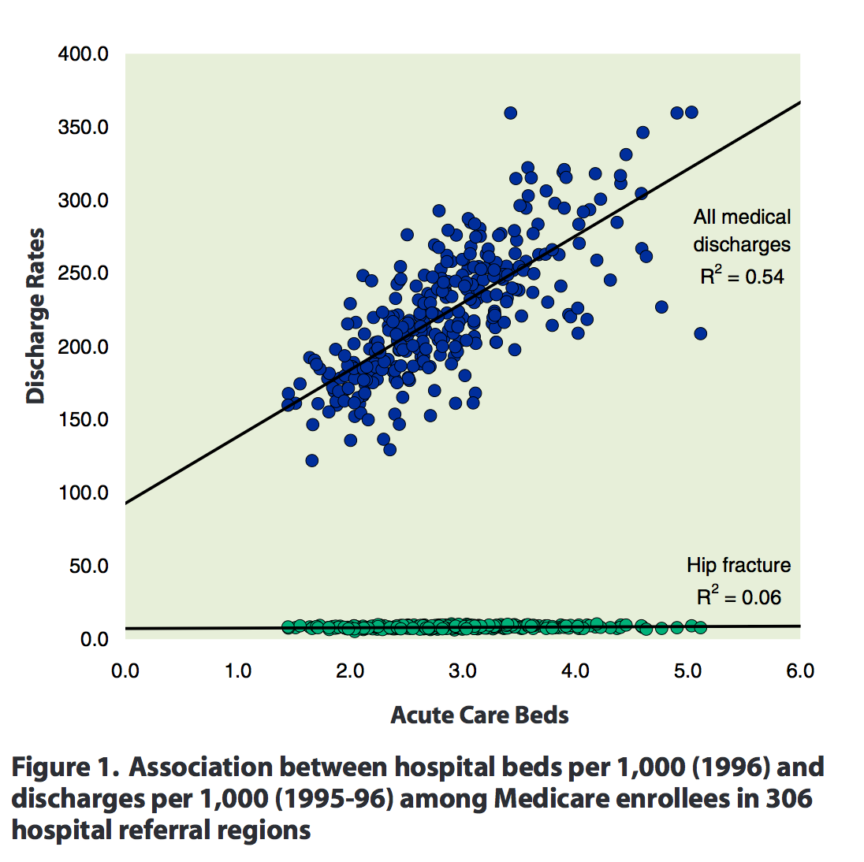
Medical practice variation

Slide 52
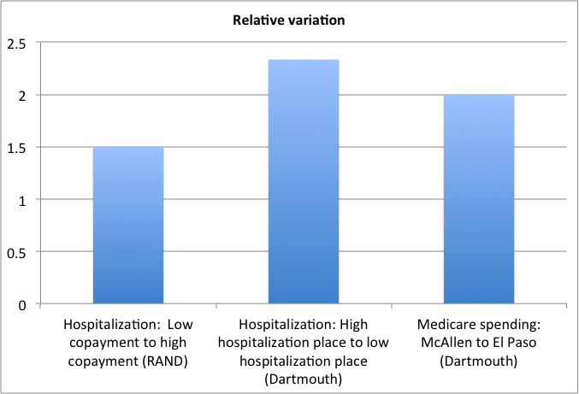

Slide 53
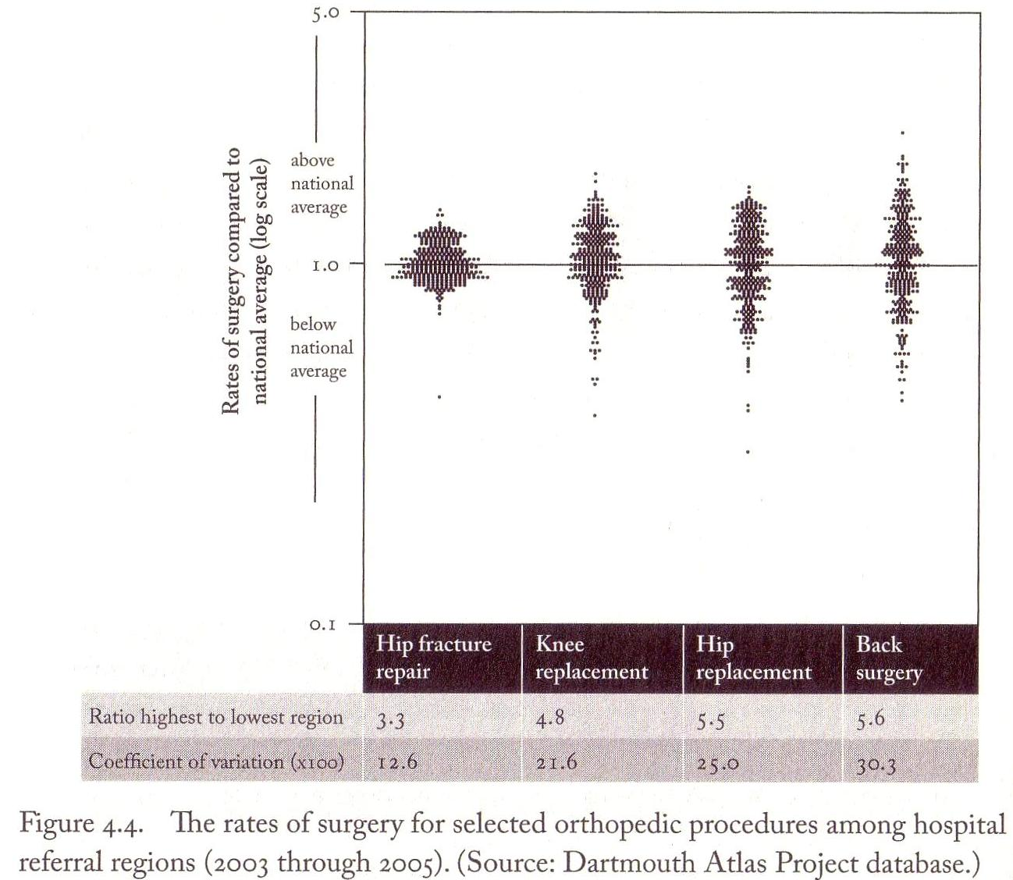

Slide 54
  Personal bankruptcy and health care
  Himmelstein, Thorne, Warren, Woolhandler
62% of all bankruptcies in 2007 had medical bills or illness as a factor.
  In 2001, it was 46%.
92% of these had medical debts over $5000 or 10% of pretax family income.
Three quarters had health insurance.

Slide 55
Health insurance among medical debtors
78% of the individuals whose illness led to bankruptcy had health insurance at the onset of the bankrupting illness
60% had private insurance.
69% of debtor families had coverage at the time of their bankruptcy filing

Slide 56
Unpaid bills among medical debtors
Hospital bills were the largest medical expense for 48% of medical debtors
Drug costs were largest for 19%
Doctors’ bills for 15%
In 62% of cases, lost income due to illness was not a factor in the bankruptcy

Slide 57
Out of pocket costs and bankruptcy
Out-of-pocket medical costs since the onset of illness averaged $17,943.
  For the privately-insured, out-of-pocket costs averaged $17,749.
  For the uninsured, out-of-pocket costs averaged $26,971.
  Patients with neurologic disorders such as multiple sclerosis faced the highest costs, an average of $34,167, followed by diabetics at $26,971.

Slide 58
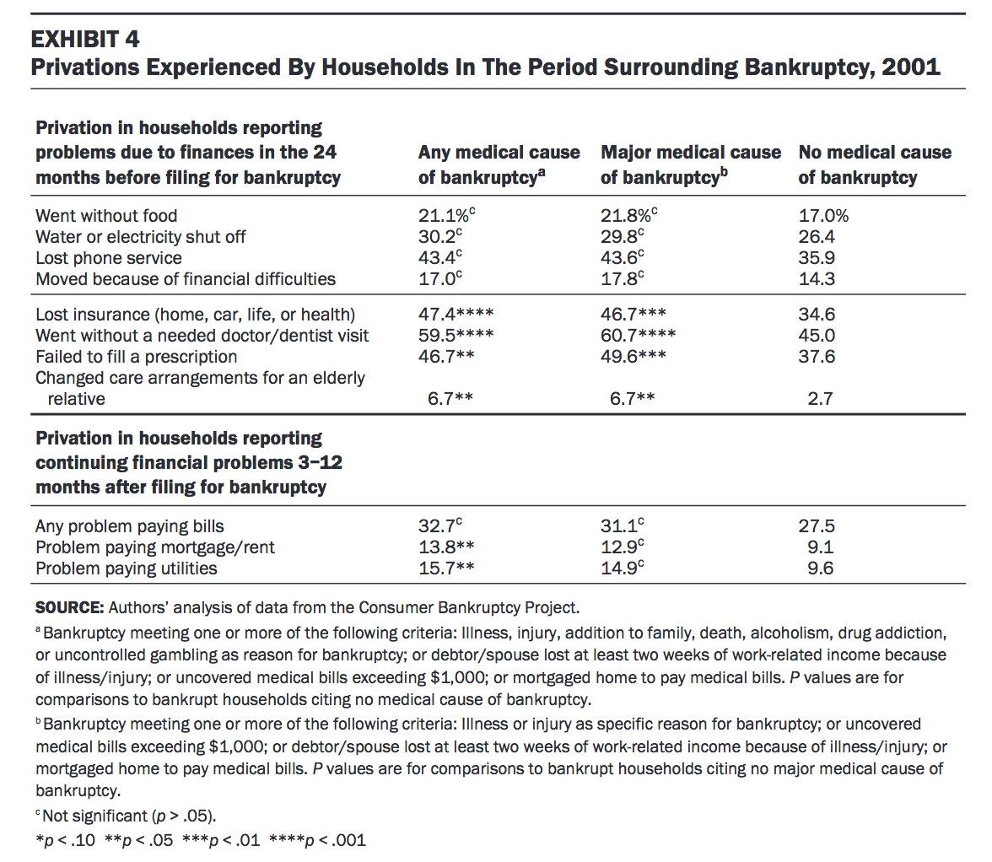

Slide 59
Canada comparison
Studies in Canada have found:
7.1% to 14.3% of bankruptcies are due to “health/misfortune”
  depending on definition.
  This category that includes some non-medical problems.

Slide 60
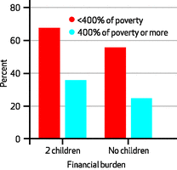
Romneycare and financial distress from medical bills
Difficulty paying medical bills among people buying health insurance via the Massachusetts Connector.
Mass. Bronze Plan pays only 40-50% of costs. Obamacare Bronze will pay 60%.
  Source: A. Galbraith, Health Affairs, 4/2013

Slide 61
